Slide 1
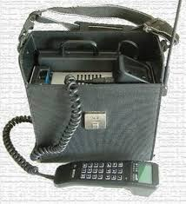
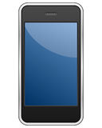
The Evolution of Mobile Phones
70's to Now i.e. Bricks to Brians

Slide 2
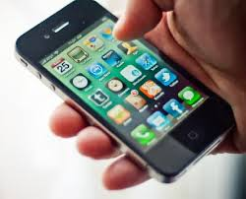
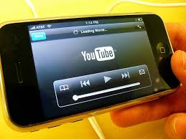
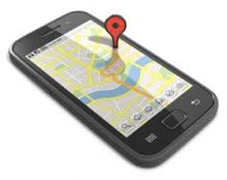
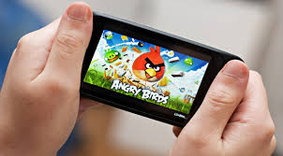
40 years back...
1. No Internet
2. No SMS
3. No touch screen
4. No GPS
5. No video
6. No camera
7. No Music
8. No Bluetooth
9. No NFC

Slide 3
1973 – The first cell phone
1. The first cell phone was developed by Motorola in 1973.
2. It was Martin cooper who placed the first call at AT&T Bells Labs from the streets if New York. FACTS:
AT&T's research arm, Bell Laboratories, introduced the idea of cellular communications in 1947. But Motorola and Bell Labs in the sixties and early seventies were in a race to incorporate
the technology into portable devices. Martin cooper made first call to his rival, Joel Engel, Bell Labs head of research. His words were:- "Joel, this is Marty. I'm calling you from a cell phone, a real handheld portable cell phone."

Slide 4
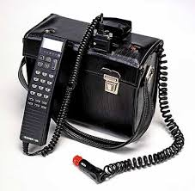
1984 – Nokia Mobira Talkman
The phone weighed under 5 kgs and is world's one of the first transportable phones.
A car and a charger was needed to charge it. FACTS: It's cost was around US $5,178 It was advertised that you can also use it out of car. (but only if you could lift it).

Slide 5
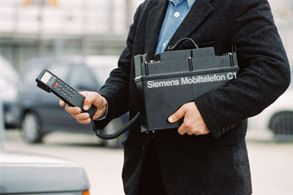
1985 – Siemens Oxford C1
Introduced in 1985 and closely resembling a car battery, this Siemens’ offering came with a handy suitcase attachment for the more image-conscious consumer.

Slide 6
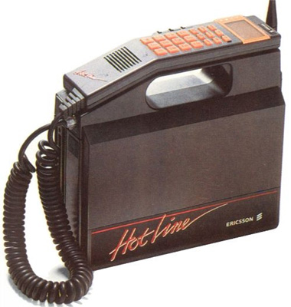
1988 - Ericsson Hotline
Pure 80s brilliance, everything from the neon orange details down to the font. With a weight of 4 kg this is exactly the type of phone that would have been used by executive types in the 80s.

Slide 7
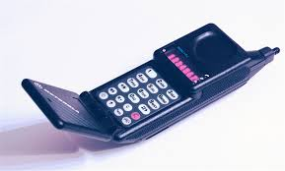
1989 – Motorola MicroTac
Motorola Microtac was the smallest and lightest available phone at that time. It was released as the “MicroTac Pocket Cellular Telephone”. It was designed keeping in the mind to fit it in a shirt pocket. FACTS: The MicroTAC introduced an innovative new flip design, where the mouthpiece folded over the keypad. The model sold for between US$2,495 and US $3,495.

Slide 8
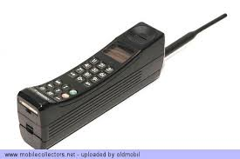
1992 – Motorola International 3200
First digital-sized mobile phone from Motorola introduced in 1992 Like its predecessors, 3200's shape & size was similar to a long brick with numeric buttons on the narrow side, along with the earphone and microphone. FACTS:
In Germany, it was called knochen, due to the resemblance in shape between it & bone. (knochen means bone in Germany)

Slide 9
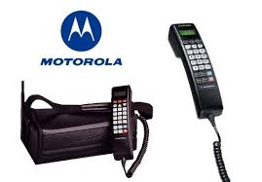
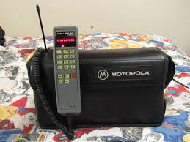
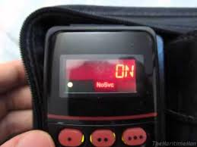
1994 – Motorola Bag Phone

Slide 10
Facts
Motorola introduced a very power line of models of mobile phones in 1992.
Because of their durability, many of these phones were in working order for many years.

Slide 11
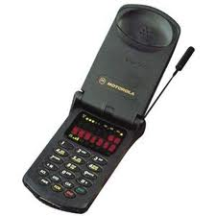
1996 – Motorola StarTac
Before StarTac cell phones were bricks. Motorola wowed the ind- dustry with this 90 grams wonder. This handset set the design precedent for years to come.
+1 for introducing vibrating ring. StarTac sold around 60 million units over the course of its long life.

Slide 12
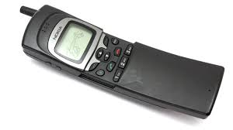
1996 – Nokia 8110
Nokia's first high-end phone was released in 1996. What made it different was the 'slider' form factor.
Slide used protect keys when phone is in pocket.

Slide 13
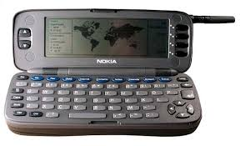
1996 – Nokia 9000 Communicator
First product in communicator series from Nokia.
On the outside, it appears phone & open in clamshell to access the QWERTY keyboard.

Slide 14
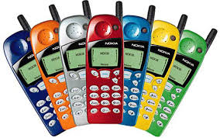
1998 – Nokia 5110

Slide 15
1998 – Nokia 5110
Everyone had these!
Nokia 5110 was the first phone to feature the game SNAKE.
Now mobile phones were not limited to just communication, they were more about fashion now. Though this wasn't Nokia's first attempt for a business phone, but this time they decided it was more of fashion. The Guardian fashion editor loved it and it wont 'Off the cuff (Fashion) Accessory of the Year Award 1998'. Nokia had jumped on a trend that started in the mobile phone acc- sessories market. People were buying new covers for old phones.

Slide 16
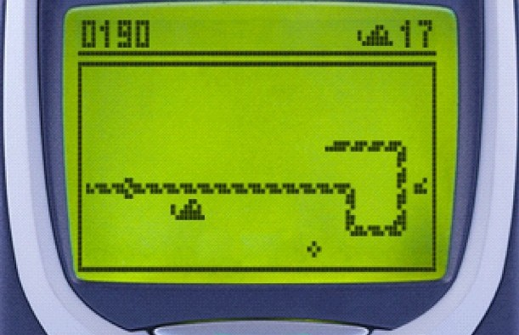
1998 – Nokia 5110
For once, we all have played this in our life!

Slide 17
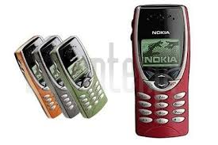
1999 – Nokia 8210
The lightest and smallest available Nokia phone at that time.
Its selling point was its customizable covers and design. This phone had feature of speed dial, like assign phone number to each no key on keypad. On the lowerside it had infra-red port for wireless communication. The phone uses SMS with predictive text input.

Slide 18
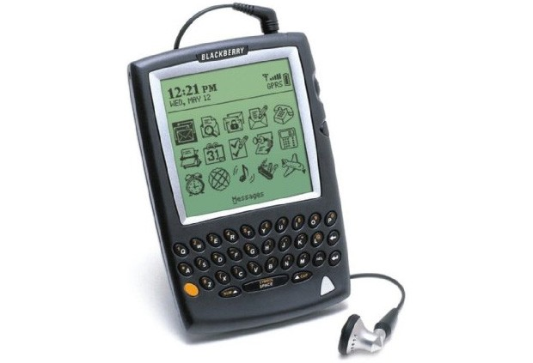
2002 – RIM BlackBerry 5810
Before this BlackBerry's' weren't phones actually. Professional's who always wanted to have access to there email used the device. This was the first BlackBerry to feature a built-in phone. Alas the lacked speaker and a microphone, so had to use headset only to make calls.

Slide 19
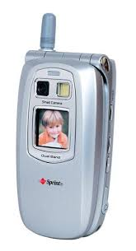
2002 – Sanyo SCP - 5300
This were first flip phones which had featured a low-quality camera as well. Features which made phone stand out of the crowd are:- It has vibrant colors, Camera with flash, PCS Businness software, Solid call quality, comes with extended battery.

Slide 20
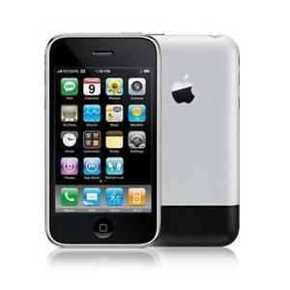
2007 – Apple iPhone
This phone changed the definition of a SmartPhone. Designed by Apple Inc, runs on Apple's iOS mobile operating system.
Apple created the device during a secretive & unprecendented collabration with AT&T, formerly Cingular Wireless. This phone was immediately listed amongst the best inventions of 2007.

Slide 21
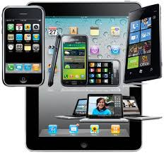
Smartphones & Tablets now

Slide 22
Thank You!
Sources:- Wikipedia, SlideShare, CNet, TalkTalk, Google Images

